Slide 1
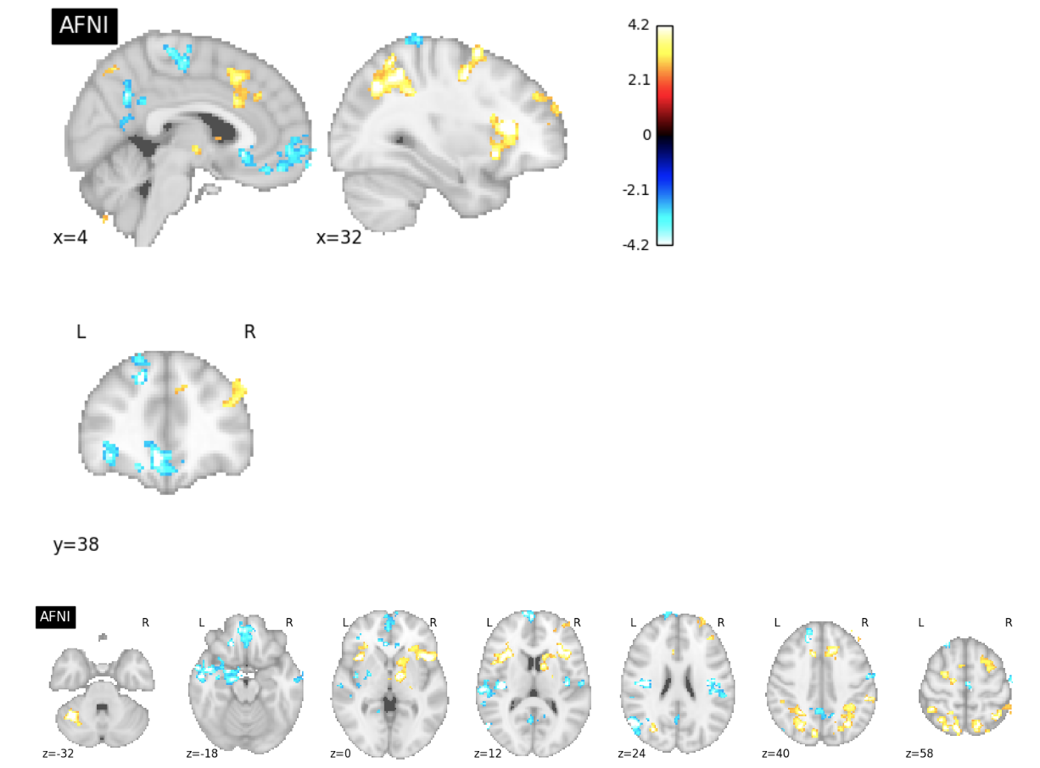
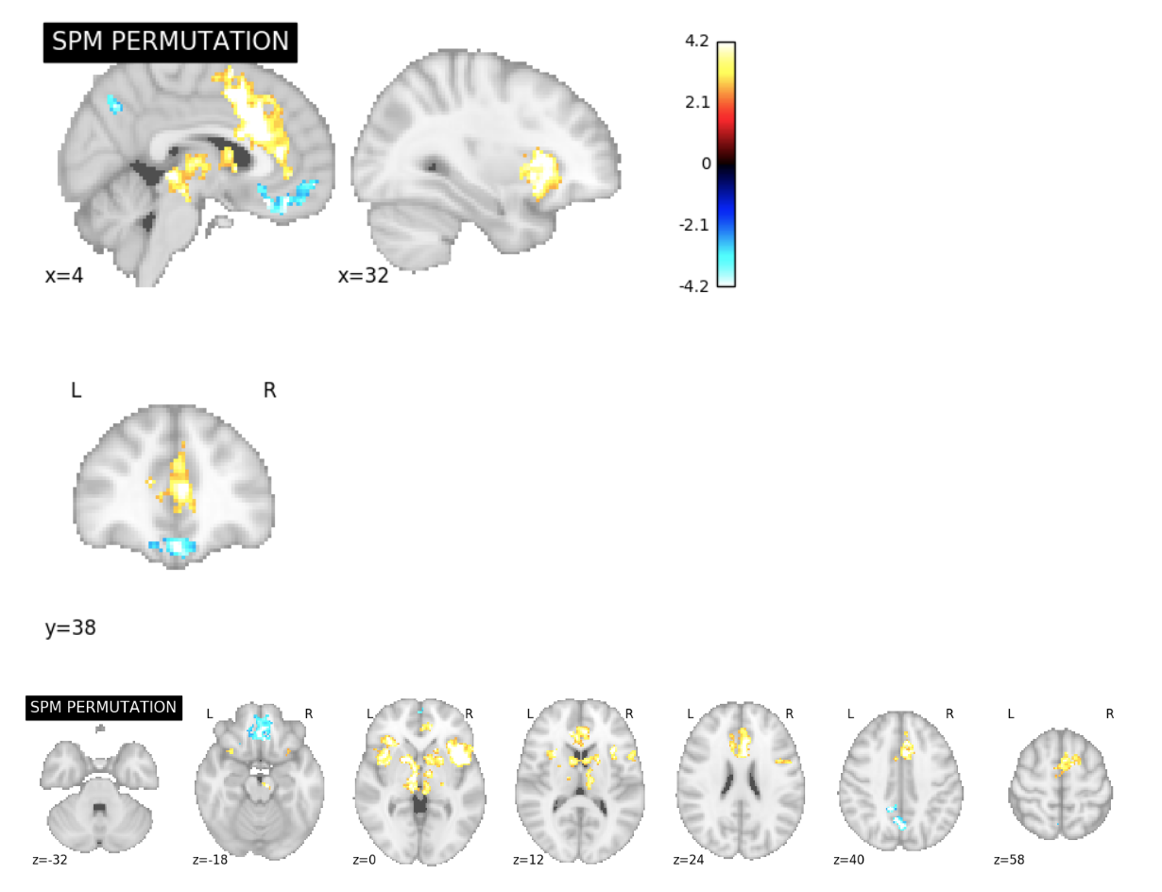
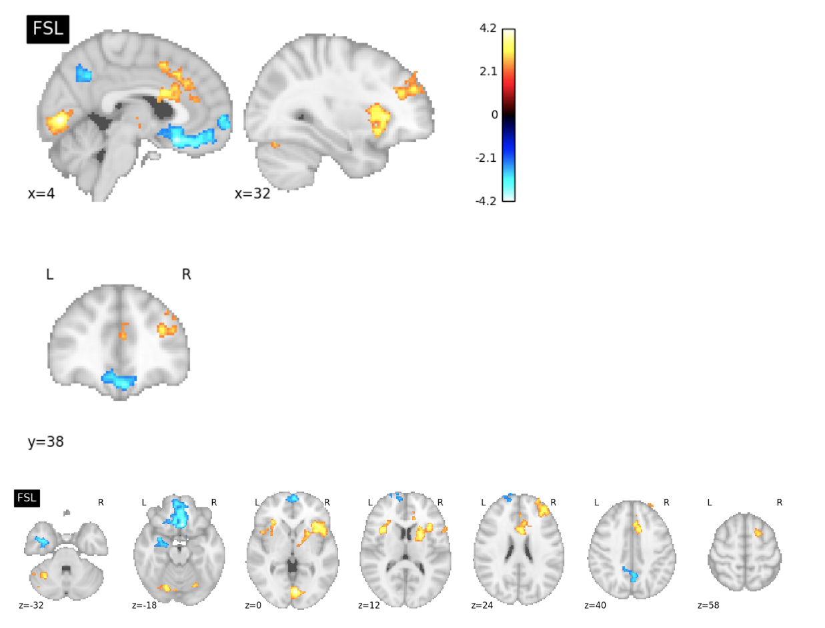
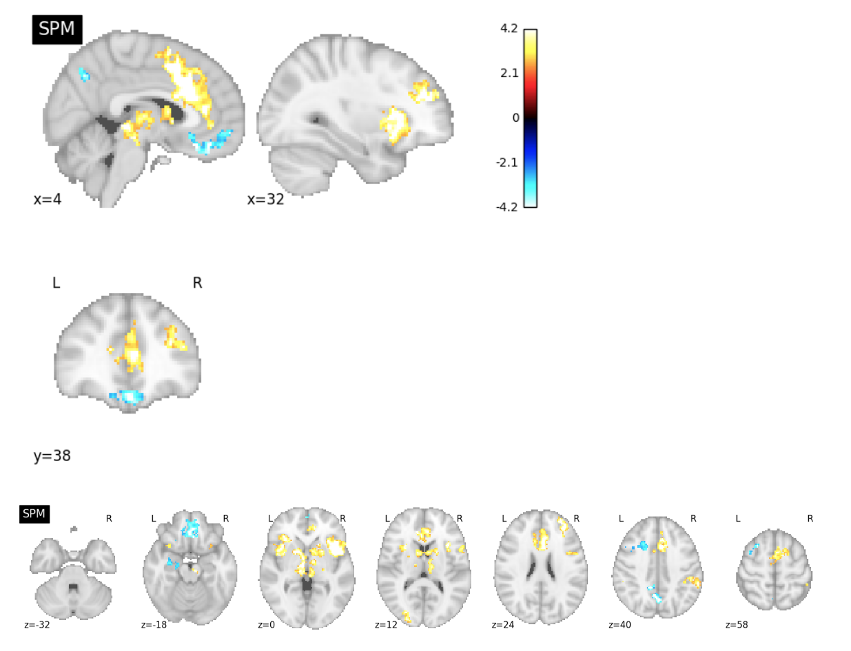
Software Comparison Figures
ds001 Reproduction Excursion Set Map Slice Comparisons

Slide 2
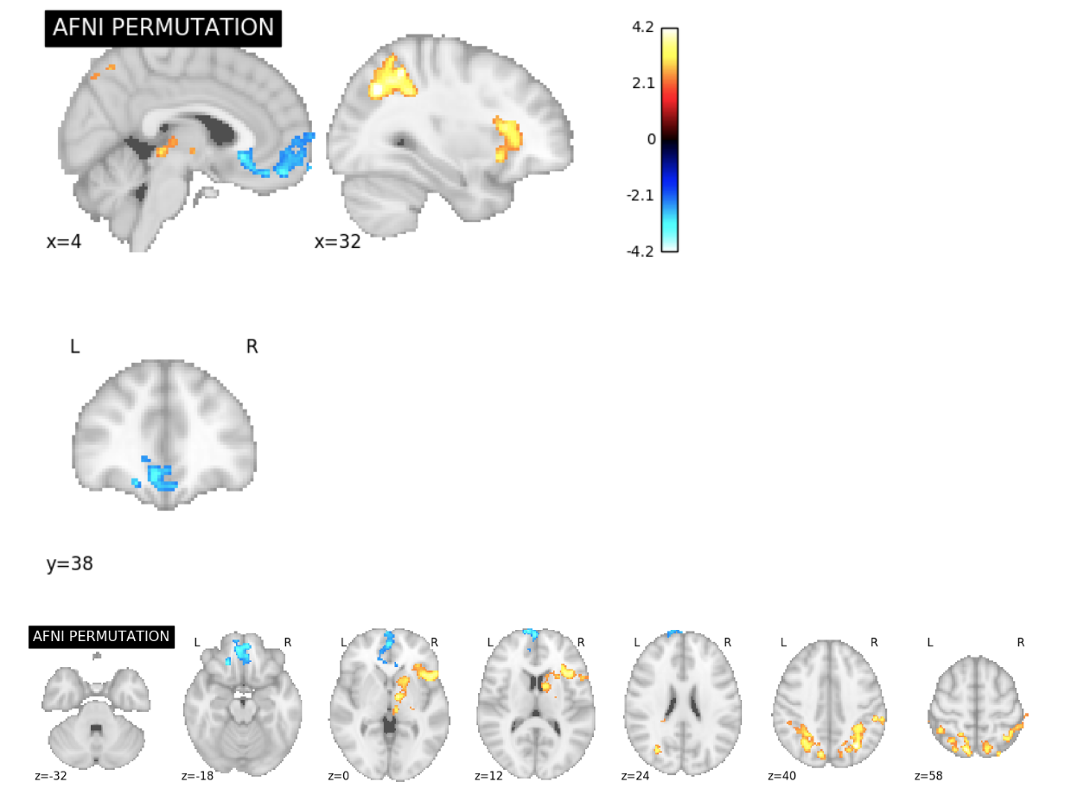
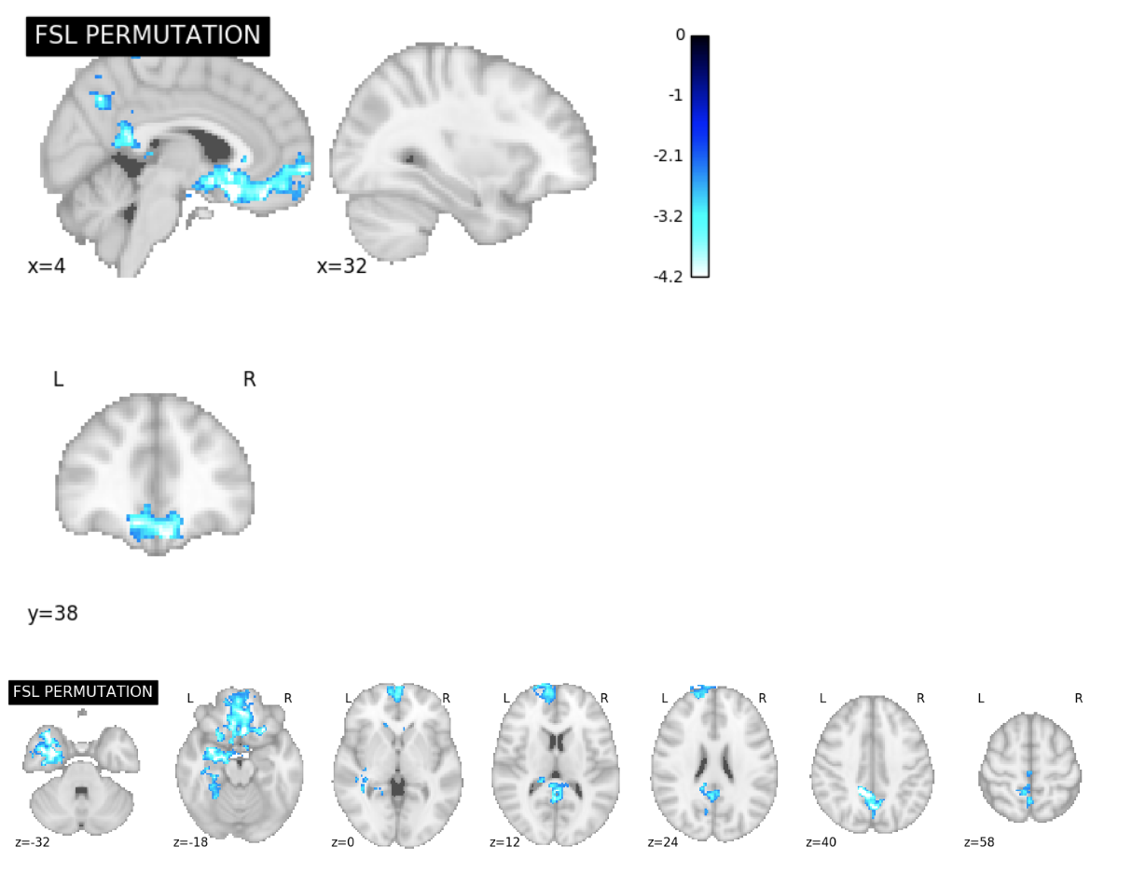
ds001 Permutation Test Excursion Set Map Slice Comparisons

Slide 3
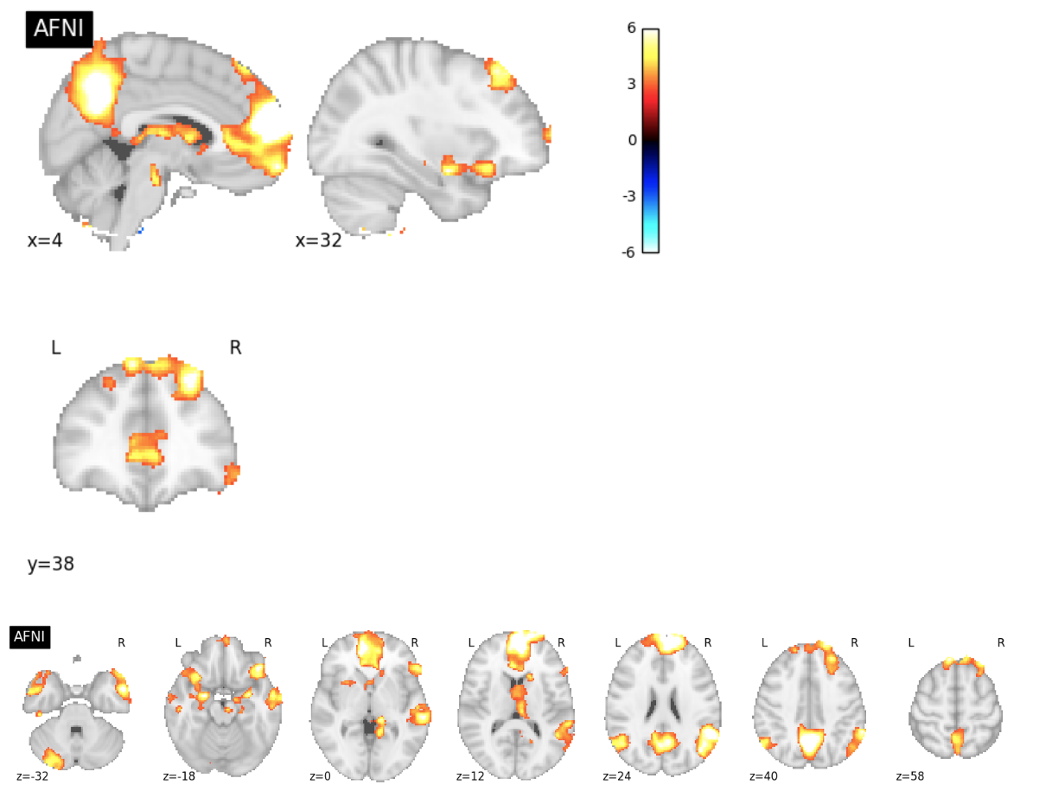
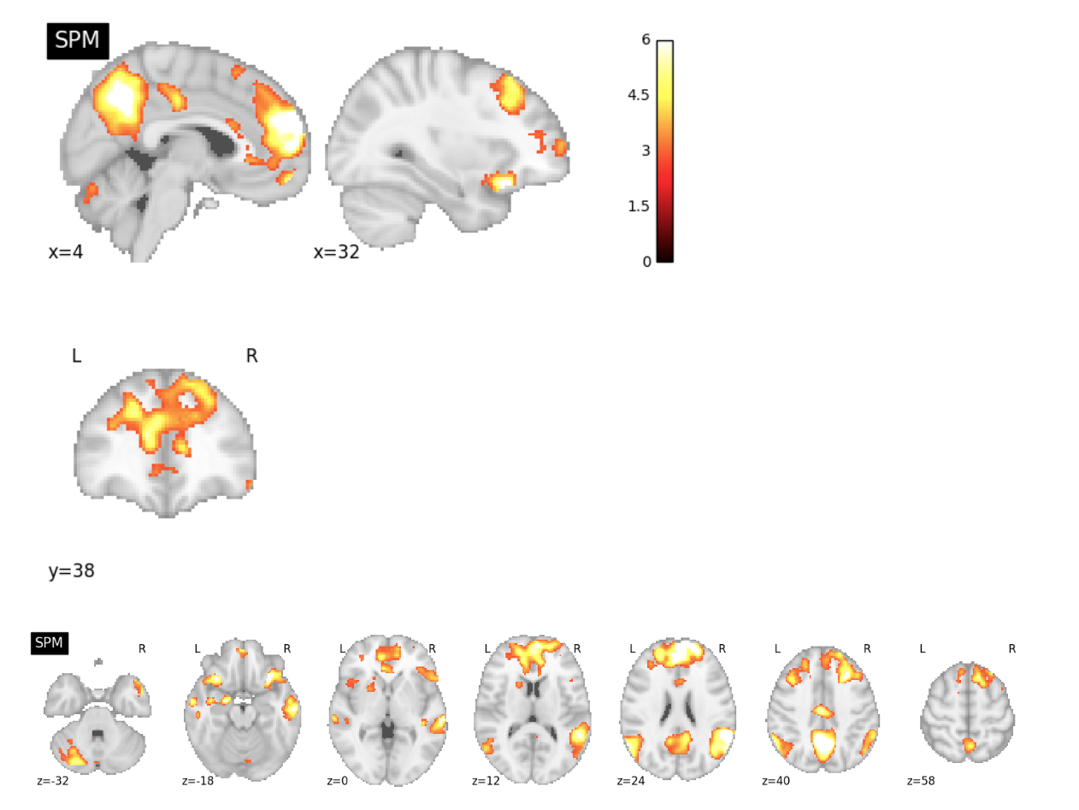
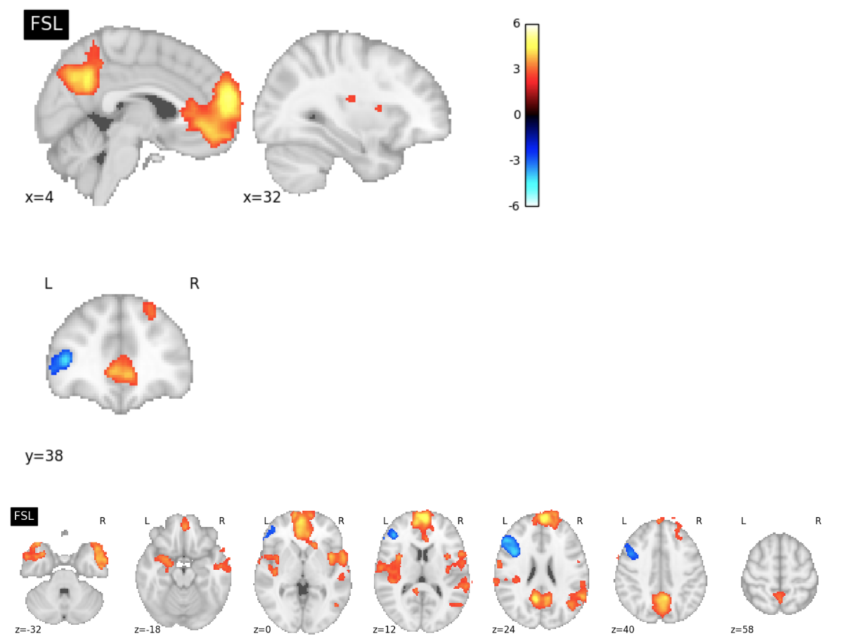
ds109 Reproduction Excursion Set Map Slice Comparisons

Slide 4
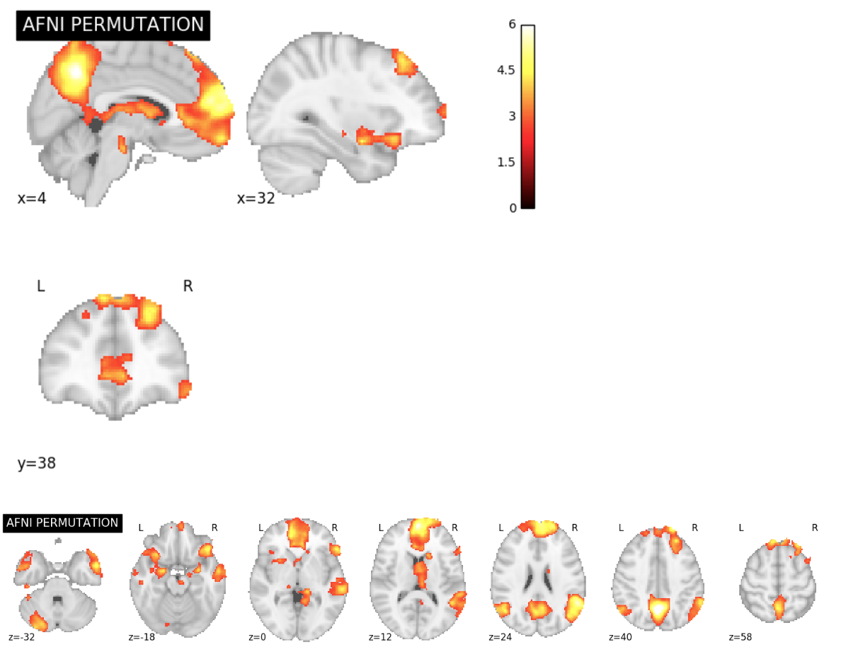
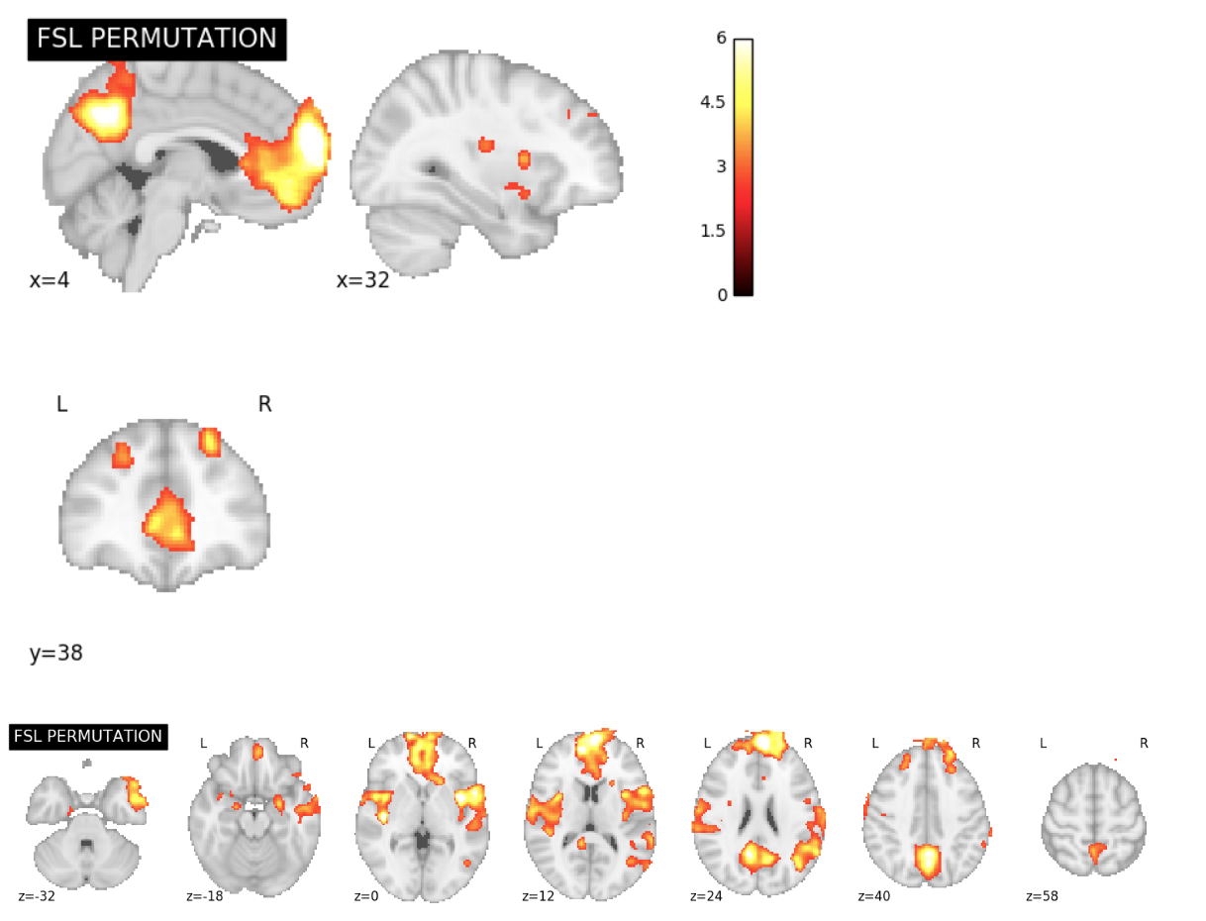
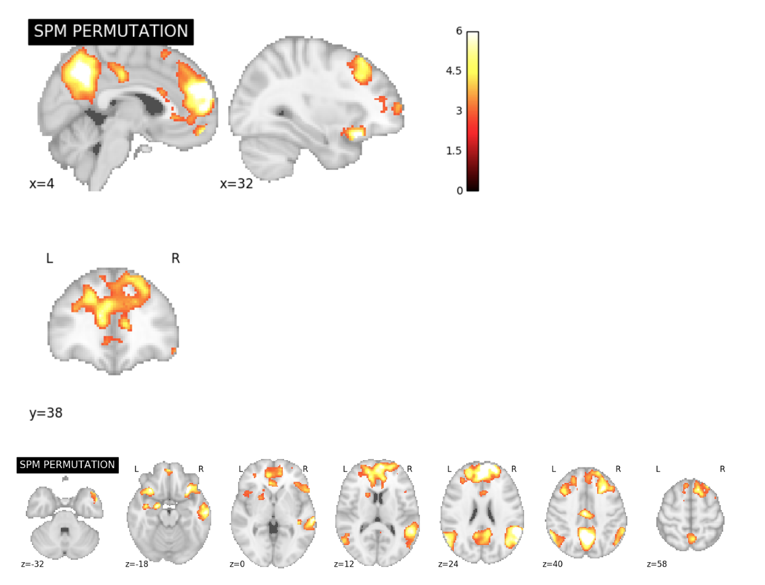
ds109 Permutation Test Excursion Set Map Slice Comparisons

Slide 5
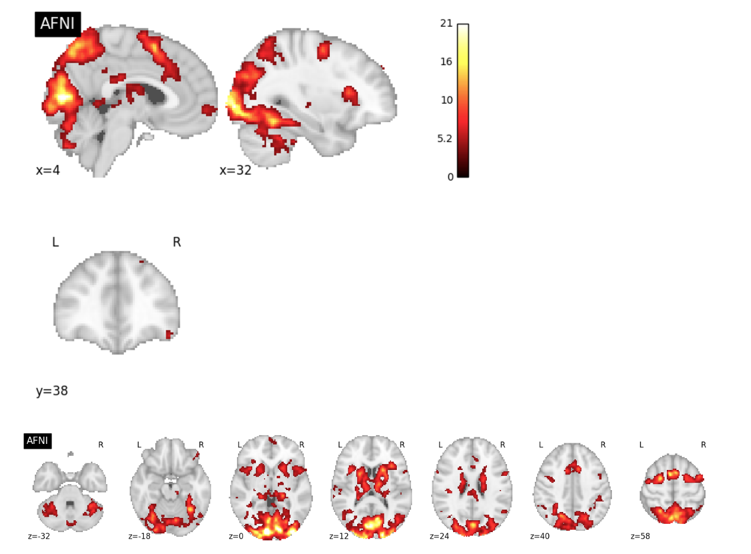
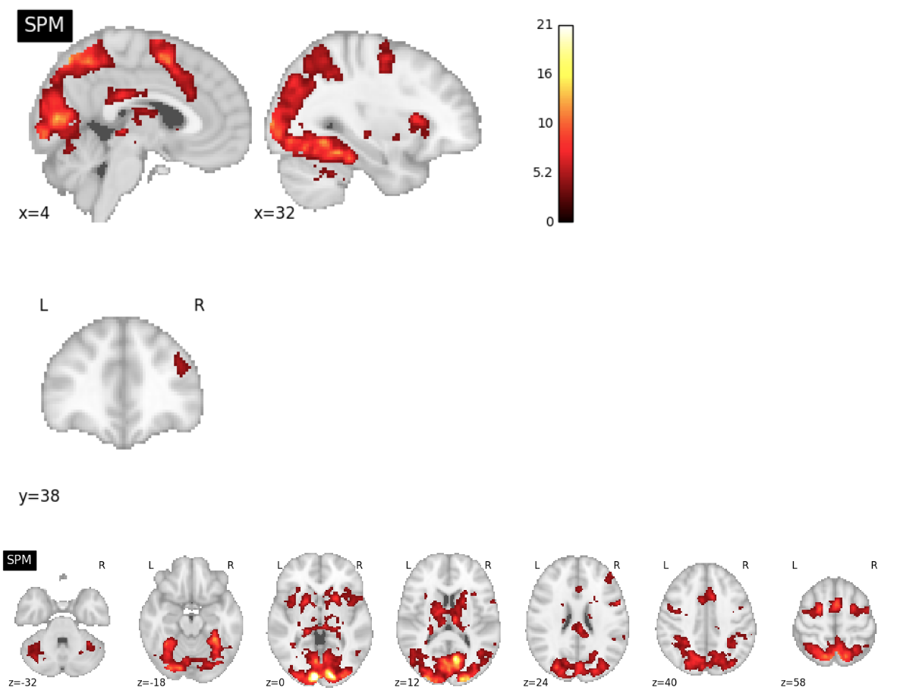
ds120 Reproduction Excursion Set Map Slice Comparisons

Slide 6
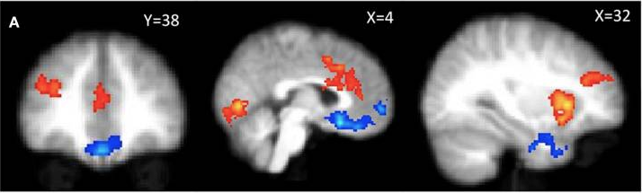
ds001 Publication Figure Reproduction
PUBLICATION
4.2
-2.3
2.3
-4.2

Slide 7
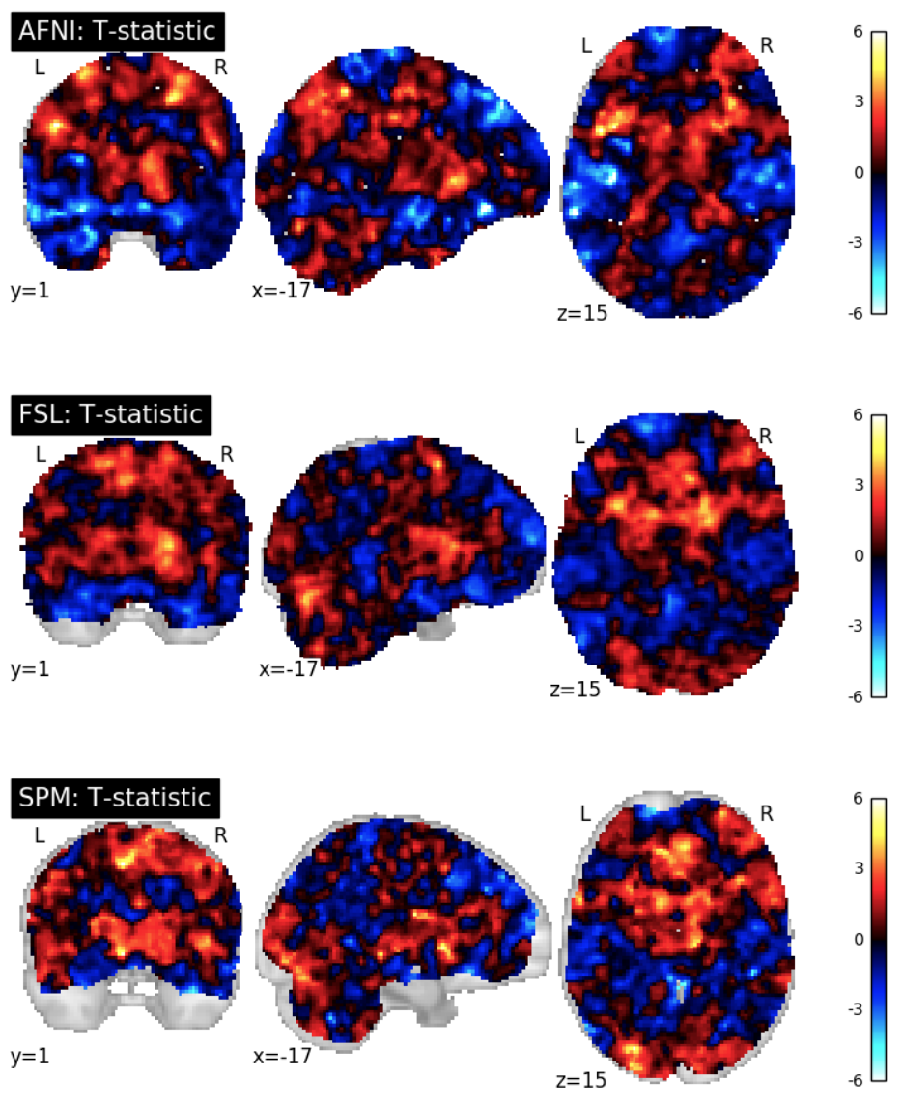
ds001 Reproduction T-Statistic Map Slice Comparisons

Slide 8
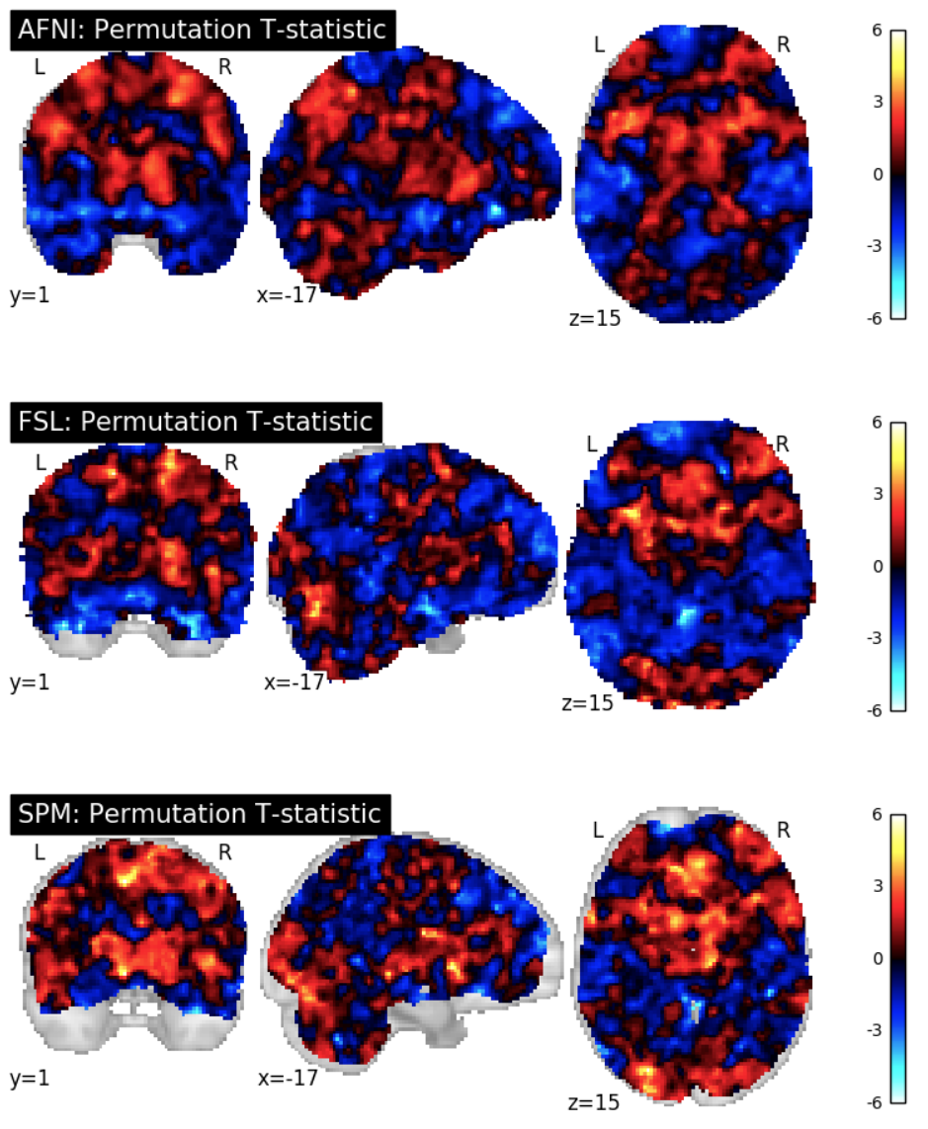
ds001 Permutation Test T-Statistic Map Slice Comparisons

Slide 9
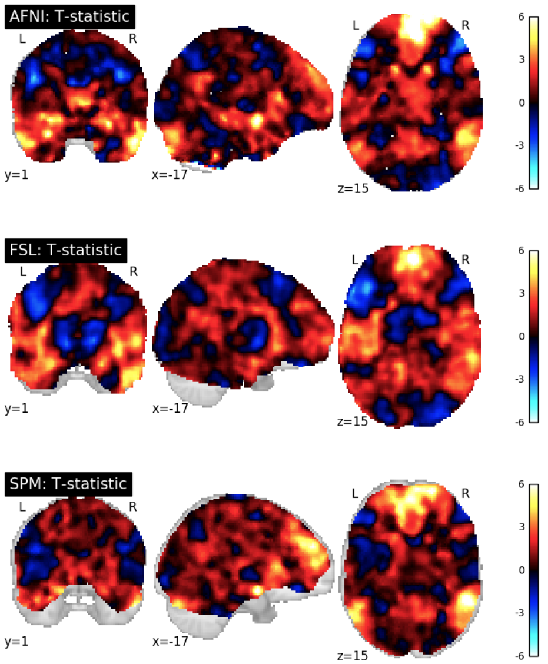
ds109 Reproduction T-Statistic Map Slice Comparisons

Slide 10
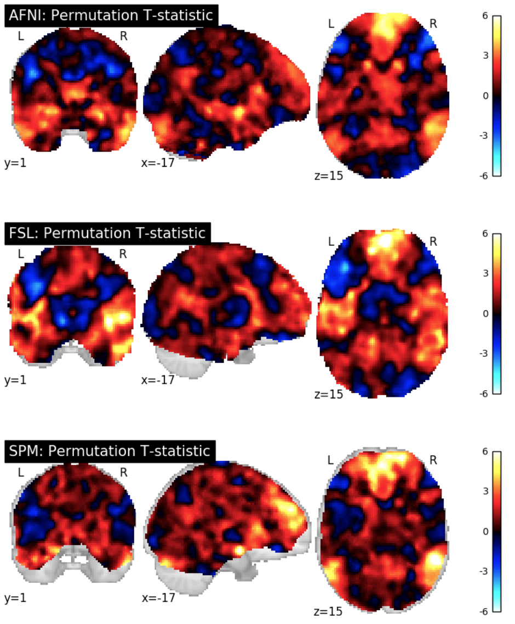
ds109 Permutation Test T-Statistic Map Slice Comparisons

Slide 11
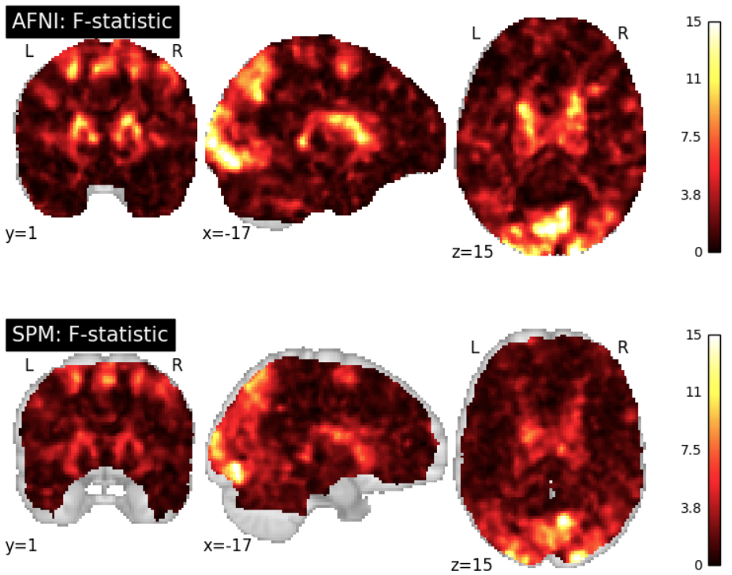
ds120 Reproduction F-Statistic Map Slice Comparisons

Slide 12
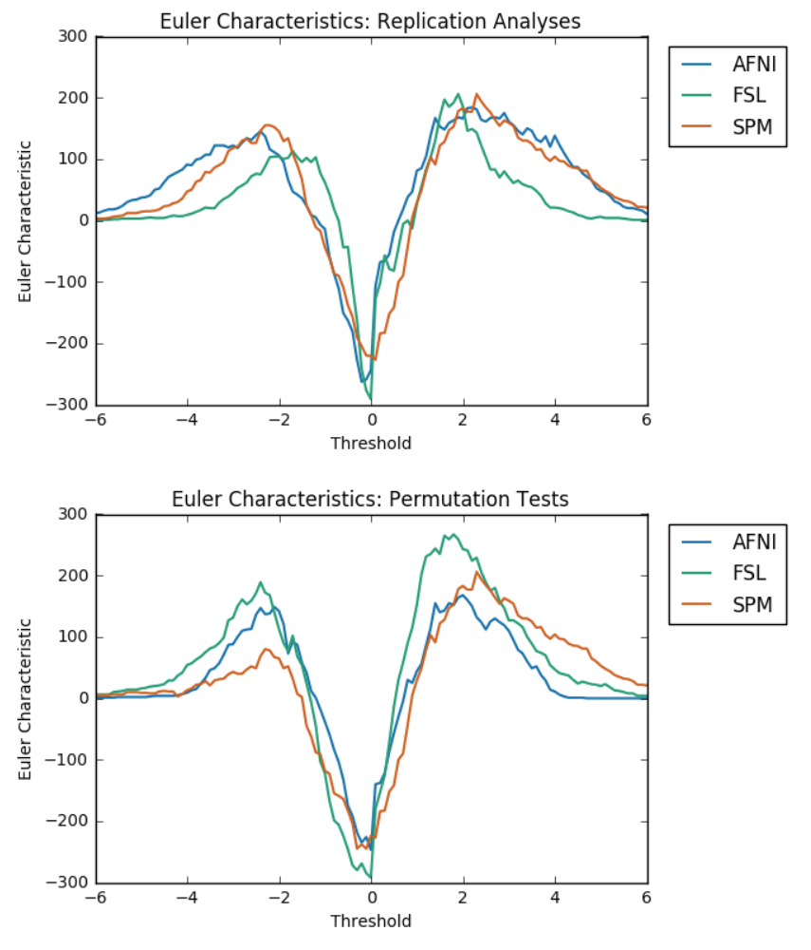
ds001 Euler Characteristics

Slide 13
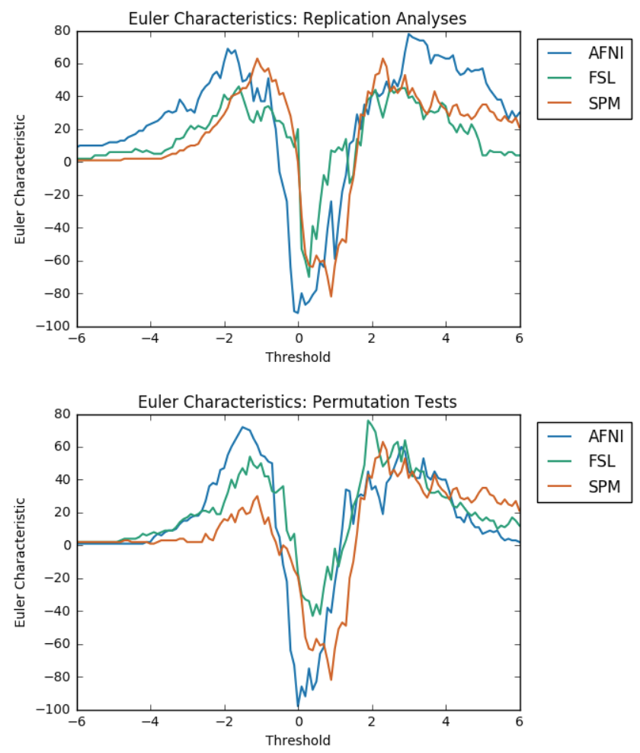
ds109 Euler Characteristics

Slide 14
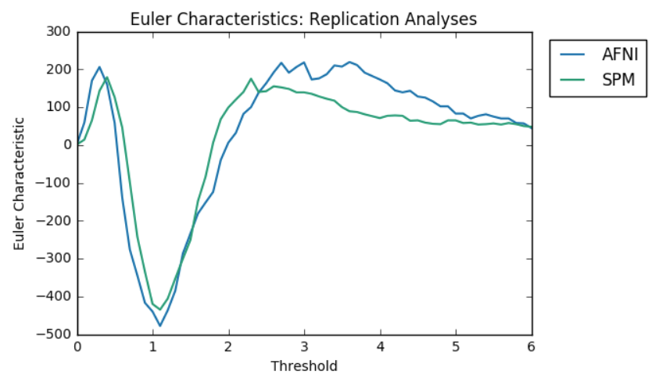
ds120 Euler Characteristics

Slide 15
Euler Characteristics
ds001
ds109
Reproduction Analyses
Permutation Test Analyses

